Slide 1
Capstone Project - 3
Cardiovascular Risk Prediction
BY
Sumit Berde
Omkar Desai

Slide 2
Problem Statement
Cardiovascular disease(CVD’s) are a group of life threatening diseases which takes millions of lives world wide.
Early diagnosis can help in saving lives as it is said that prevention is better can cure. If our model is able to identify persons, who are at most risk of getting of CVD’s then it would greatly help doctors to save lives by starting early diagnosis and reduce the chances of death.
Our project aims at building ML models to detect high risk persons who are most vulnerable towards suffering from CVD’s

Slide 3
Workflow
The steps involved are as follows
Data Collection and Understanding
Data Cleaning and Data Wrangling
EDA
Preparation of Data for Model Building
Model Selection and Evaluation
Conclusions

Slide 4
Data Collection And Understanding
This project is based on medical domain dataset and it has been collected from various patients. It includes entries of over 3000 patients and has 17 different attributes for the prediction of Coronary Heart Disease in patients for the next ten years
It includes 3390 records and 17 attributes. Variables each attribute is a potential risk factor. There are both demographic, behavioral and medical risk factors
Data Description
Sex : male or female(‘M’ or ‘F’)
Age : age of patient
Is_smoking : whether or not the patient is a smoker(‘Yes’ or ‘No’)
Cigs per day : the number of cigarettes that the person smoked on average in one day

Slide 5
Bp meds : whether or not the patient was on blood pressure medication(Yes / No)
Prevalent Stroke : whether or not the patient previously had a stroke(Yes / No)
Prevalent Hyp : whether or not the patient was hypertensive(Yes / No)
Diabetes : whether or not the patient had diabetes (Yes / No)
Tot Chol : total cholesterol level
Sys BP : systolic blood pressure
Día BP : diastolic blood pressure
BMI : Body Mass Index
Heart rate : heart rate
Glucose : glucose level
Ten year chd : 10 year risk of coronary heart disease(Target variable)

Slide 6
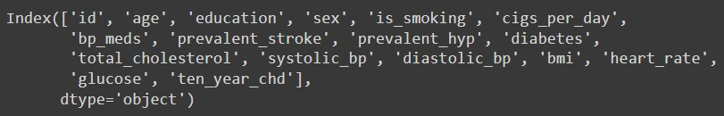
Data Cleaning and Data Wrangling
Categorical features : is_smoking, sex, bp_meds, prevalent_hyp, prevalent_stroke. diabetes
Numerical features : age, cigs_per_day, total_cholesterol, systolic_bp, diastolic_bp, bmi, heart rate, glucose
1. Rename columns: We have renamed columns to give appropriate name to features and removed spaces in-between

Slide 7
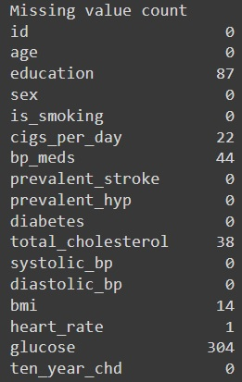
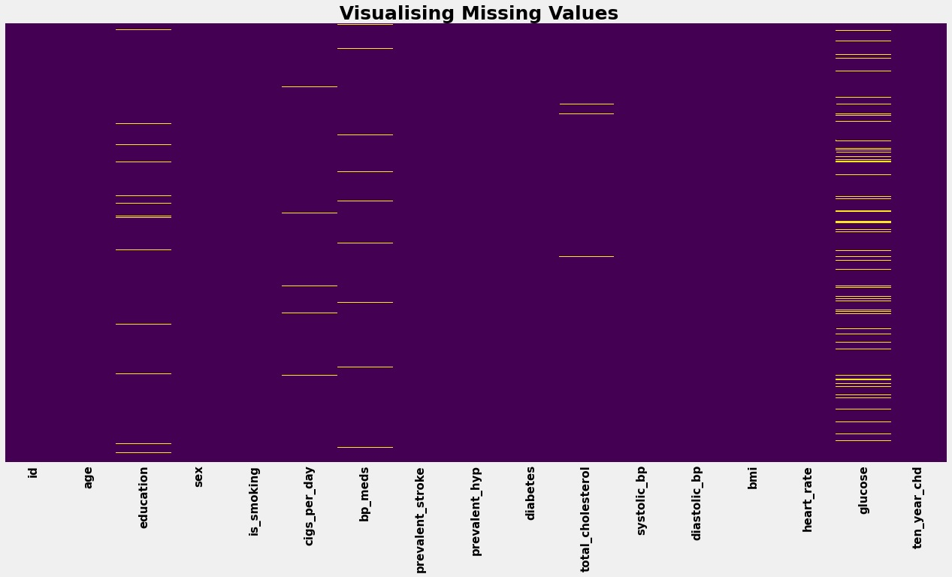
2. Checking for duplicate rows : We had zero duplicate rows in our dataset
3. Checking for missing values : Missing values were present in education, cigs_per_day, bp_meds, total_cholesterol, bmi, heart_rate, glucose

Slide 8
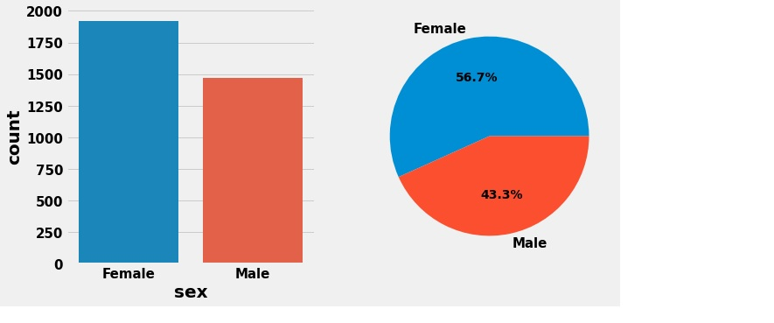
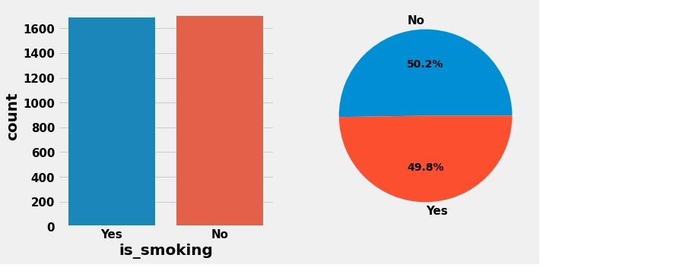
EDA(Exploratory Data Analysis)
Univariate Analysis
Frequency Distribution in Categorical Features

Slide 9
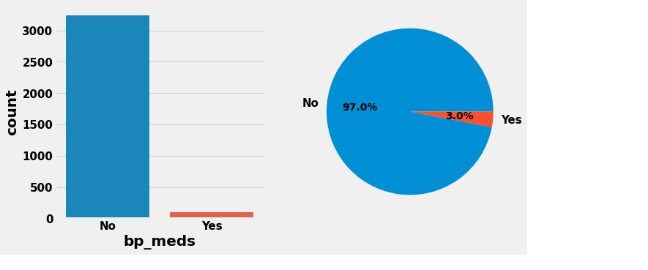
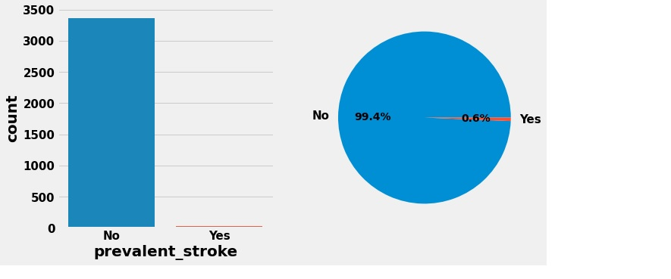

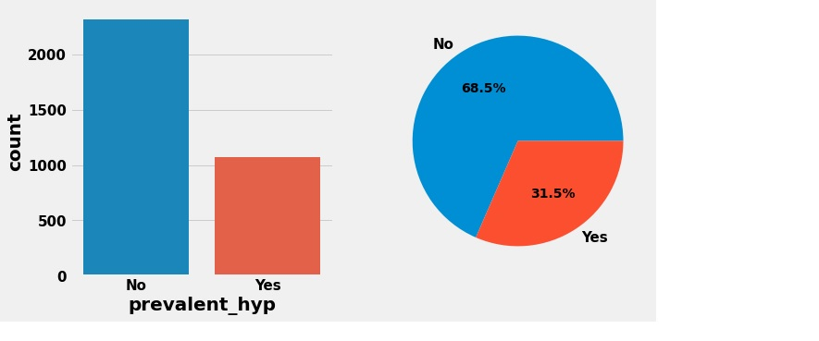

Slide 10
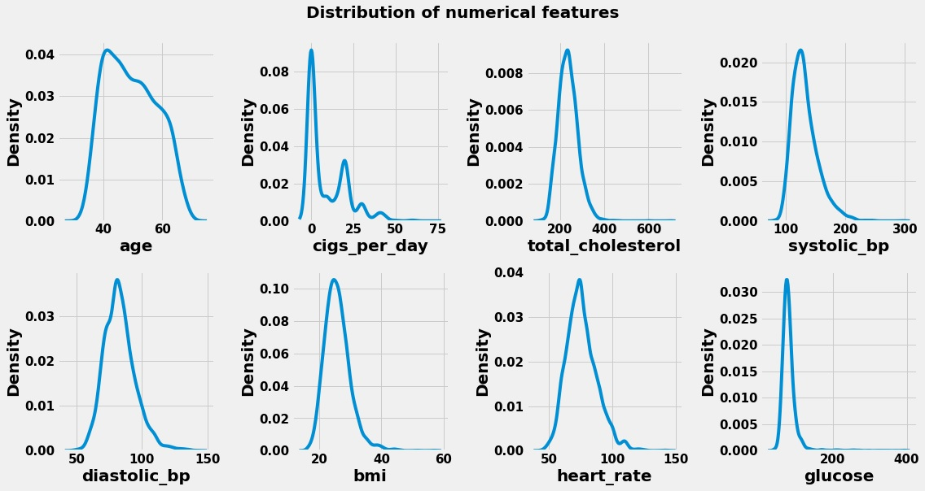
Checking distribution of data in numerical features

Slide 11
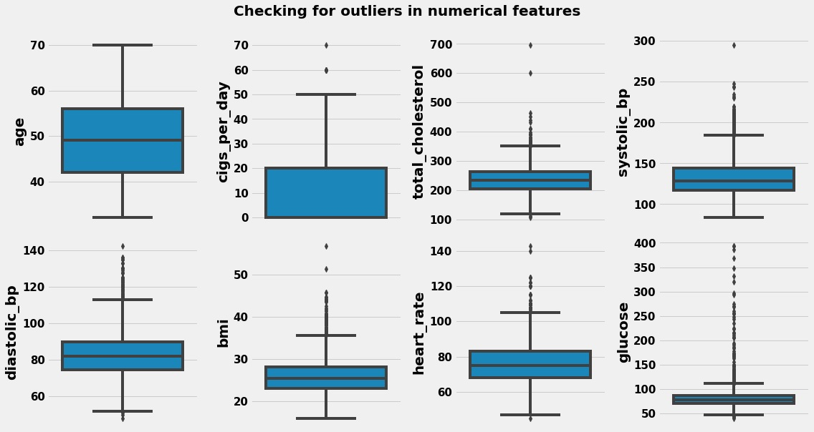
Checking for outliers in numeric features

Slide 12
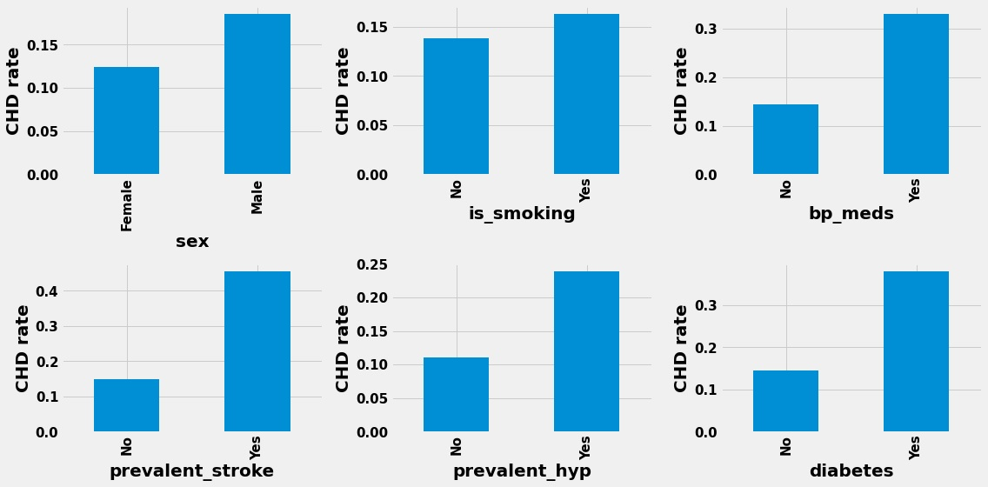
Bivariate and Multivariate Analysis
Rate of people having cardiovascular disease within categories
Observations:
Males seems to have higher rate of contracting heart disease than
females
Smoking increases the chances
of getting heart disease
as more individuals who smoke
seems to suffer from
heart disease
It looks like if someone has
premedical conditions such
as blood pressure medication,
prevalent stroke, prevalent
hypertension and diabetes his
chances of getting heart
disease increases

Slide 13
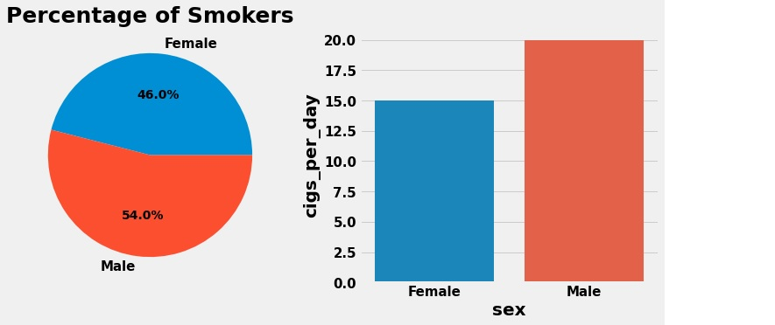
Now lets do a detailed study about how various factors like smoking and pre-medical conditions like blood pressure medication, prevalent stroke, hypertension, diabetes effects your chances of contracting heart disease
Percentage of male and female smokers and then finding the average cigarettes smoked by males and females
Observations:
Out of all the smokers, 54% are
males and 46% are females
Males on an average smoke
more than females

Slide 14
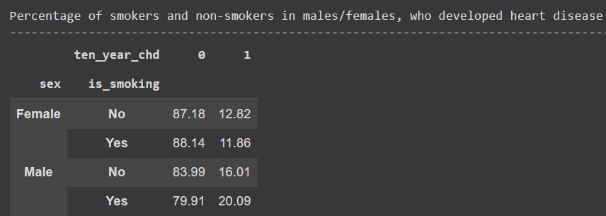
Observations:
In males, smoking seems to have
increased the chances of
getting heart disease.
Out of all male smokers,
20.09% of them eventually
suffered from heart disease.
As compared to male
nonsmokers only 16.01% of
them suffered from heart disease.
There is 4% increase in chances
in males of getting heart
disease due to smoking
In females there seems to be no
effect of smoking. But we think
it may be due to insufficient data

Slide 15
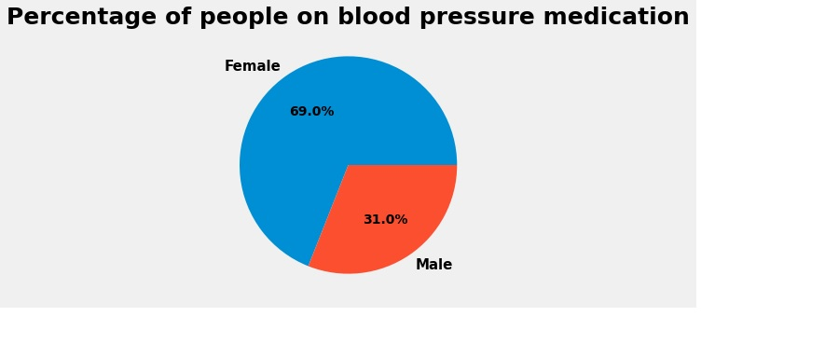
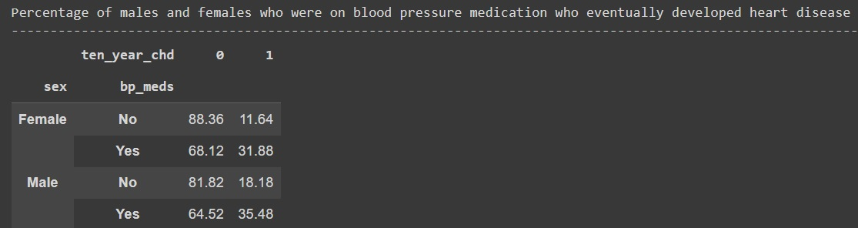
Percentage of males and females that were on blood pressure medication. Then finding
how blood pressure medication effects your chances of having heart disease
Out of all those people those who were on blood pressure medication 69% were females and 31%
were males
In both males and females, the effect of blood pressure medication can be seen. In males out of all
people who were on blood pressure medication 35.48% eventually contracted heart disease,
whereas in females 31.88% contracted heart disease
In males those who were not on blood pressure medication only 18.18% people contracted heart
disease and in females 11.64% contracted heart disease. Being on blood pressure
medication increases your chances of getting heart disease

Slide 16
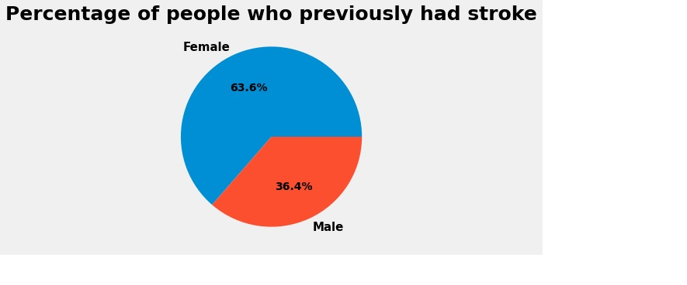
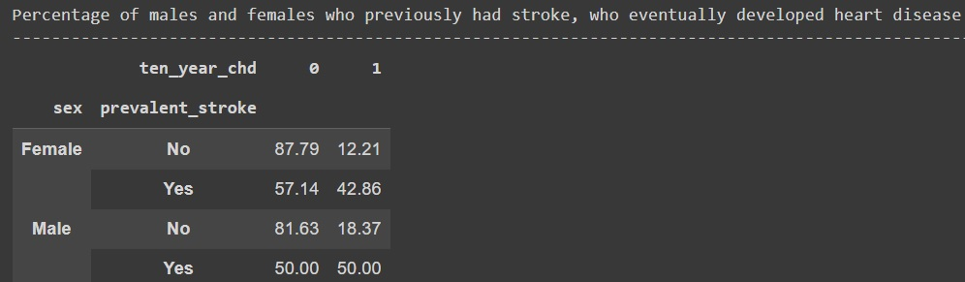
Percentage of males and females who had prevalent stroke. Then finding out how
having prevalent stroke effects your chances of having heart disease
Out of those people those who had prevalent stroke 63.6% were females and 36.4% were males
50% of males who had stroke eventually developed heart disease and 42.86% of females who had stroke developed heart disease
Having prevalent stroke, significantly increases your chances of having heart disease

Slide 17
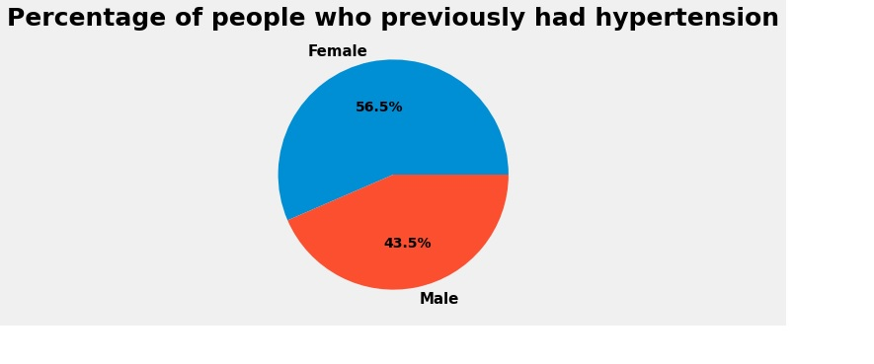
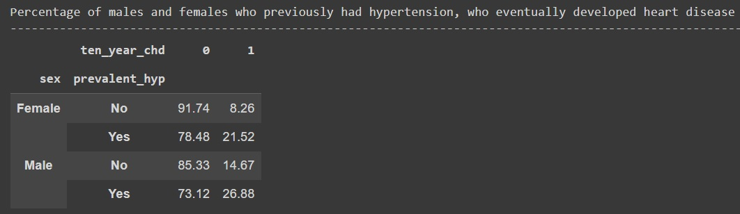
Plotting to find percentage of males and females who had prevalent hypertension. Then
finding out how having prevalent hypertension effects your chances of having
heart disease
Out of all those people who had hypertension, 56.5% were females and 43.5% were
males
26.88% of males who previously had hypertension developed heart disease and 21.52%
of females who had hypertension developed heart disease
So having hypertension increases your chances of having heart disease

Slide 18
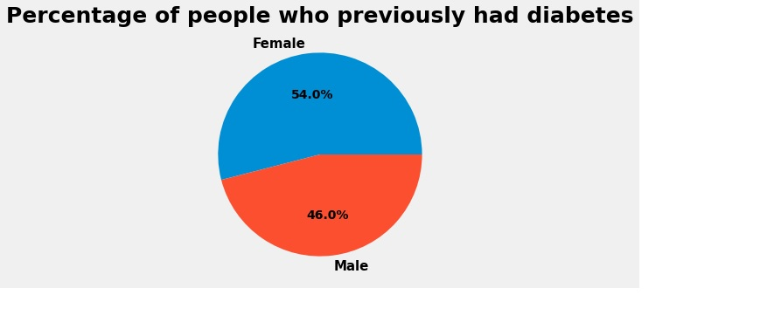
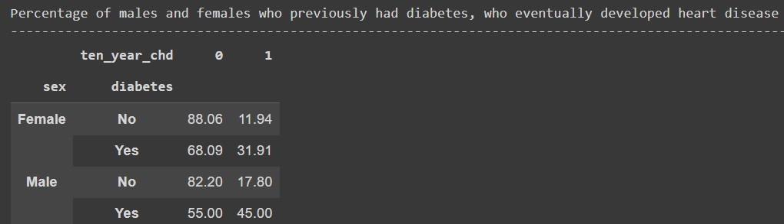
Percentage of males and females who had diabetes. Then finding out how having
diabetes effects your chances of having heart disease
Out of all those people who had diabetes, 54% were females and 46% were males
45% of males who had diabetes developed heart disease and 31.91% of females
who had diabetes developed heart disease
So having diabetes plays a role in person developing heart disease

Slide 19
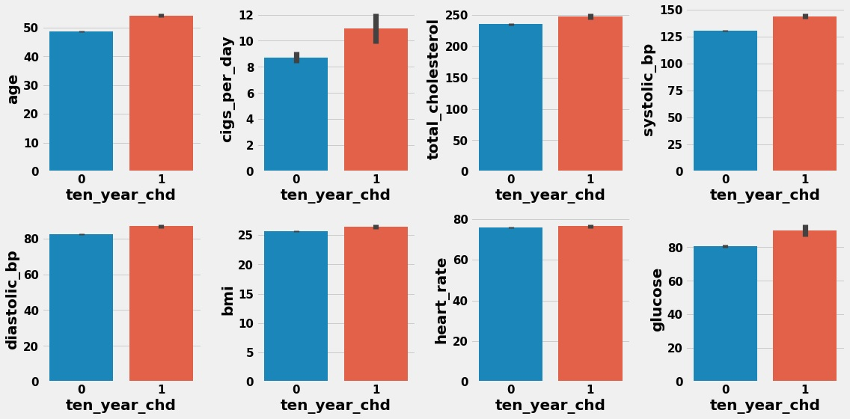
Plotting barplot to find the average value of numerical features when people contract
heart disease and when people do not contract heart disease
Age , cigs_per_day , total_cholesterol , systolic_bp , diastolic_bp , glucose generally have high values for people developing heart disease as compared to people who not develop
heart disease
Heart rate and bmi seems to be same for people developing heart disease and
for people not developing heart disease

Slide 20
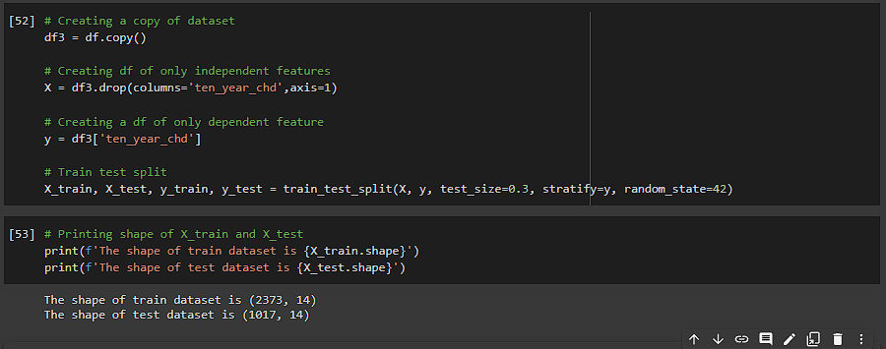
Preparation Of Data For Model Building
1) Data Splitting: Before performing any feature engineering step, we need to split the data into a training and testing dataset to prevent data leakage.
Since the data is imbalanced, a stratified split was employed to get an almost equal proportion of dependent variables in the training and test sets.

Slide 21
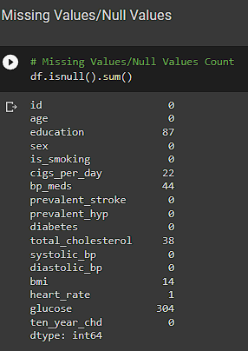
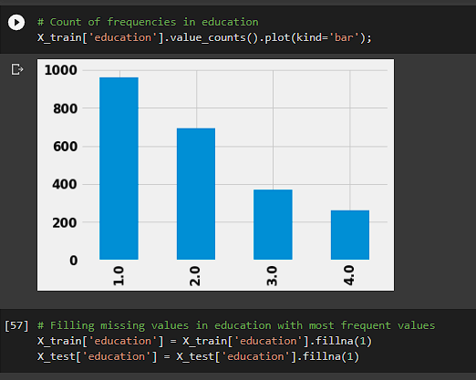
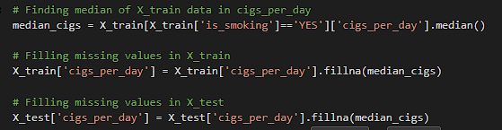
2) Handling Missing values : As in our dataset, some features contain missing values, so before model building we need to take care of them.
Each feature will have a different impact on our model, so we use a different imputation technique to fill in missing values in each feature.
In the education column, we fill in missing values with the most frequent category.
We fill missing values for cigs_per_day by taking the median of the cigs per day column who actually smoke.

Slide 22
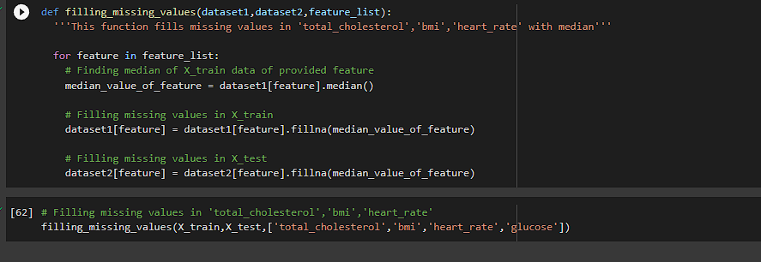
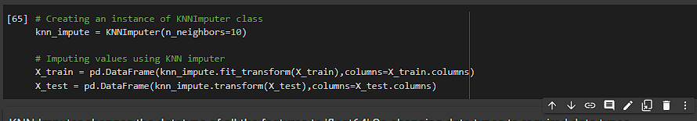
Continued
3) For the bp_meds column, if we impute values with the most frequent values, i.e., "No," we are making a huge assumption that the person was not on blood pressure medication. Hence, it’s better to drop missing rows.
4) For remaining columns such as total_cholesterol, bmi, and heart_rate we impute missing values with the respective column median value.
5) As the glucose column has 8% missing values. If we use the median to impute, there is a great chance of disturbing the distribution of glucose. Also, glucose is an important feature, so we use the KNN imputer for accurate results.

Slide 23
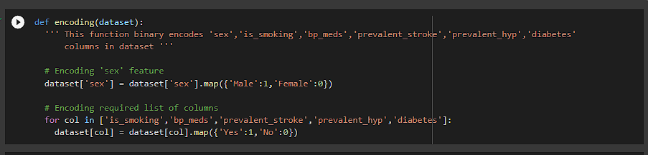
3) Categorical Encoding: As all our categorical features have binary labels so we have use binary label encoding technique.
For ‘sex’ column,(male=1,Female = 0)
For ‘is_smoking’ column (yes =1 ,No=0)
For ‘bp_meds’ column (yes =1 ,No=0)
For ‘prevalent_stroke’ column (yes =1 ,No=0)
For ‘prevalent_hyp’ column (yes =1 ,No=0)
For ‘diabetes’ column (yes =1 ,No=0)

Slide 24
4) Handling Skew and Outliers:
The skew in numeric variables is reduced by performing log transformation.
The outliers beyond 3 standard deviations from the mean were imputed with the median value
Attribute | Original skew | Skew After Transformation
age | 0.208197 | -0.036952
cigs_per_day | 1.249114 | 0.274297
total_cholesterol | 1.122804 | -0.041904
pulse_pressure | 1.407770 | 0.295810
bmi | 0.982133 | 0.178421
heart_rate | 0.675533 | 0.086530
glucose | 6.529257 | 0.431254

Slide 25
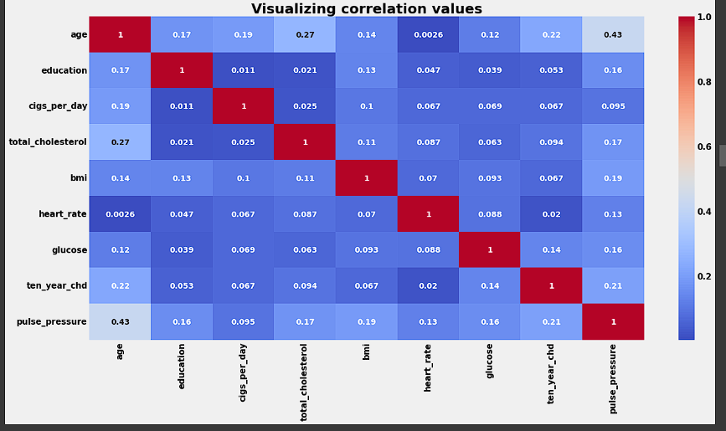
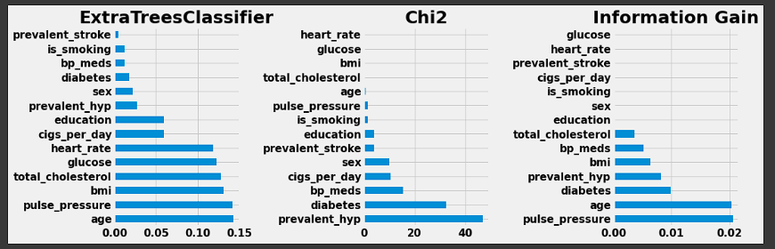
5) Feature Manipulation and Selection:
removing multicollinearity: As in our dataset Systolic blood pressure and diastolic blood pressure are highly correlated. Hence to solve multicollinearity we create new feature.
Pulse pressure = Systolic BP – Diastolic BP
Different feature selection methods we used such as :
Gini Impurity
Chi2 Test
Information Gain
From chi2 test we can clearly see that ‘is_smoking’ column has the highest p-value so is the least relevant feature. As a result, we drop it.

Slide 26
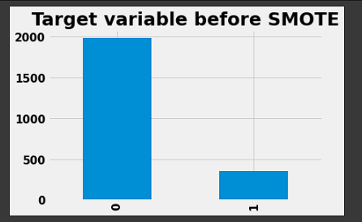
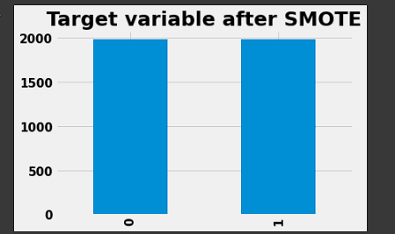
6) Data Scaling:
Since predictions from the distance-based models will be affected if the attributes are in different ranges, we use StandardScaler to scale down the variables.
7) Handling Imbalanced Dataset:
Since we are dealing with unbalanced data, i.e., only 15% of the patients were diagnosed with coronary heart disease, we oversample the training dataset using SMOTE (Synthetic Minority Oversampling Technique).
This will ensure that our model has been trained equally on all kinds of results and is not biased towards one particular result.

Slide 27

Model Selection And Evaluation
Before starting model building, it’s important to choose the evaluation metric.
We have chosen recall as the evaluation metric. Because this is a health-care dataset, it is critical to predict who is most likely to develop heart disease. We are fine with a false positive (the model predicted heart disease and the person did not get heart disease), but a false negative (the model did not predict heart disease and the person got heart disease) is very dangerous as the person may lose his life.

Slide 28
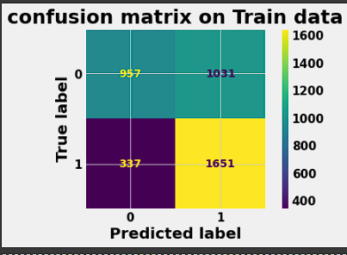
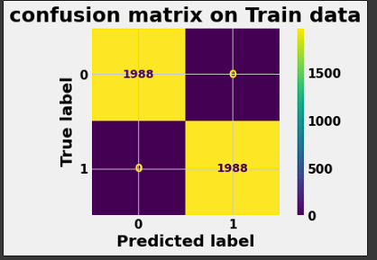
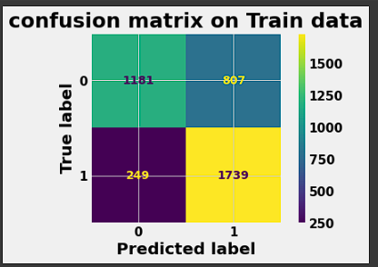
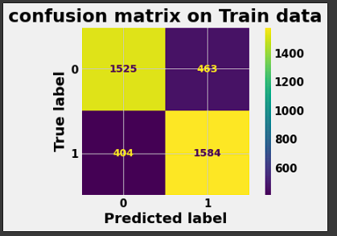
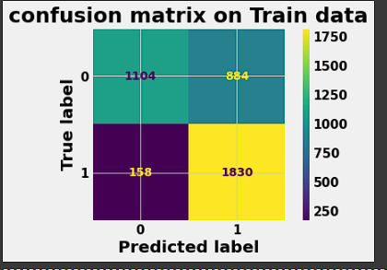
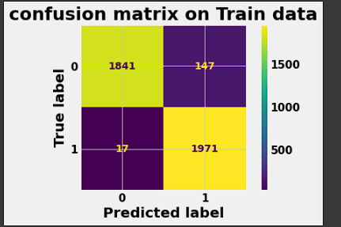
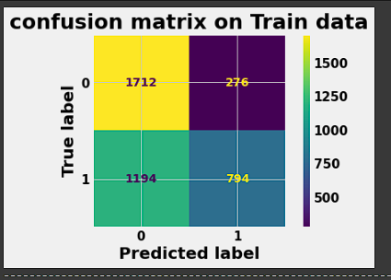
Logistic Regression
Confusion Matrix of models fro Train Data:
KNN
Decision Tree
XG Boost
Random Forest
Support Vector Machines
Naive Bayes

Slide 29
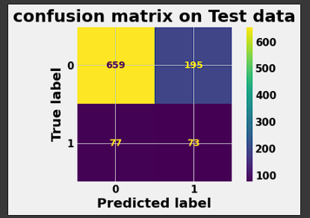
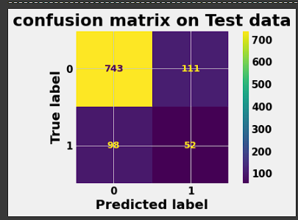
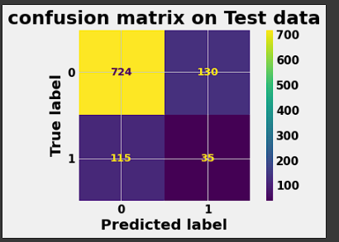
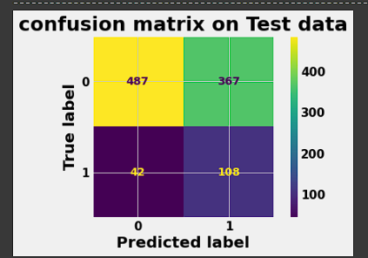
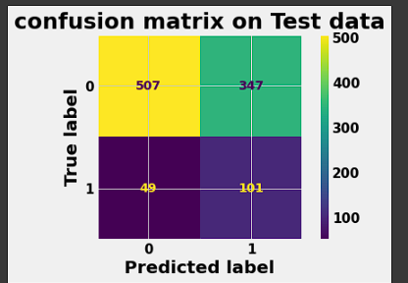
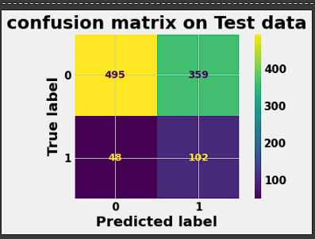
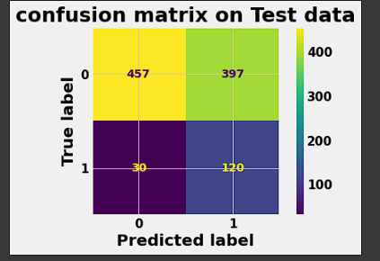
Confusion Matrix of models for Test Data:
XG Boost
Naive Bayes
Support Vector Machine
Random Forest
Decision Tree
KNN
Logistic Regression

Slide 30
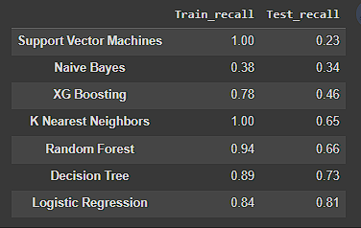
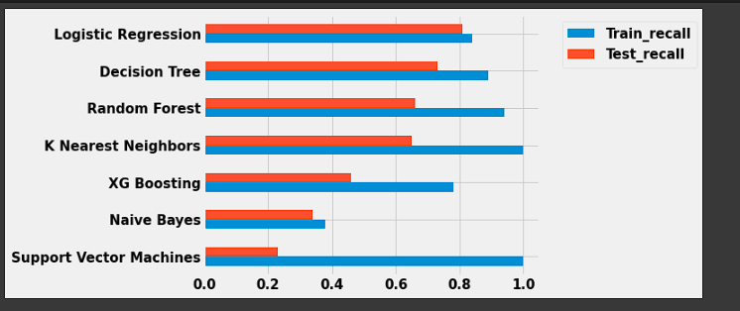
1. 'Logistic Regression' and 'Decision Tree' were the two best performing models
2. But here we can observe that Decision Tree has overfitted as it has relatively large difference between train recall and test recall
3. Logistic Regression seems to have generalized well on the given data.
4. Hence we have selected 'Logistic Regression‘ as model for deployment

Slide 31
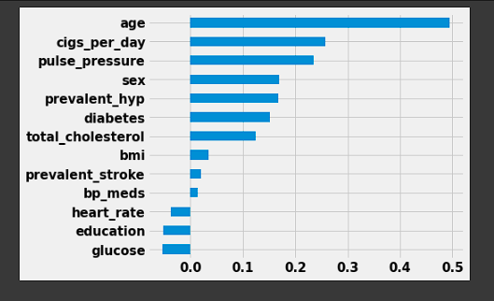

Feature Importance and Model Explainability
'Age' is the most important feature which influences the probability of getting a heart disease.Olderly people are most at risk of getting a heart attack
'Cigs per day', 'Prevalent hypertension' and 'Pulse Pressure' are next important features. Smoking and having high pulse pressure increases the chances of getting a heart attack

Slide 32
Conclusion
We trained 7 machine learning models using the training dataset, and hyperparameter tuning was used in some models to improve the model's performance.
Missing values were handled, feature engineering and feature selection were carried out, and the training dataset was oversampled using SMOTE to reduce bias on one outcome.
We chose recall as the model evaluation metric because it was critical that we reduce false negatives.
Predicting the risk of coronary heart disease is critical for reducing fatalities caused by this illness. We can avert deaths by taking the required medications and precautions if we can foresee the danger of this sickness ahead of time.
It is critical that the model we develop has a high recall score. It is OK if the model incorrectly identifies a healthy patient as a high risk patient because it will not result in death, but if a high risk patient is incorrectly labelled as healthy, it may result in fatality.6)We were able to create a model with a recall of just 0.81 because of limitated data available and limited computational power available.
A recall score of 0.81 indicates that out of 100 individuals with the illness, our model will be able to classify only 81 as high risk patients, while the remaining 19 will be misclassified.
Future developments must include a strategy to improve the model recall score, enabling us to save even more lives from this disease. This includes involving more people in the study, and include people with different medical history, etc. build an application with better recall score.
From our analysis, it is also found that the age of a person was the most important feature in determining the risk of a patient getting infected with CHD, followed by pulse pressure, prevalent hypertension and total cholesterol.10) Diabetes, prevalent stroke and BP medication were the least important features in determining the risk of CHD.

Slide 33
Thank You

